Slide 1
DOCKER

Slide 2
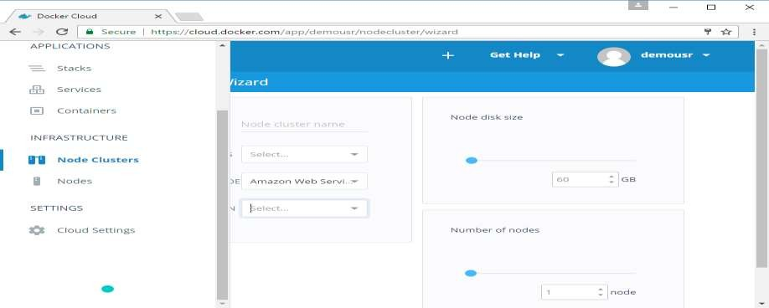
Setting Up Nodes
Once the integration with AWS is complete, the next step is to setup a node. Go to the Nodes section in Docker Cloud. Note that the setting up of nodes will automatically setup a node cluster first.
Step 1: Go to the Nodes section in Docker Cloud.

Slide 3
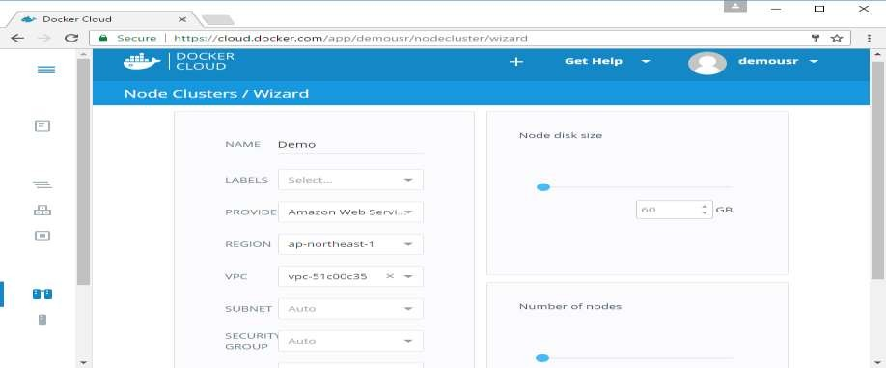
Step 2: Next, you can give the details of the nodes which will be setup in AWS.
You can then click the Launch Node cluster which will be present at the bottom of the screen. Once the node is deployed, you will get the notification in the Node Cluster screen.

Slide 4
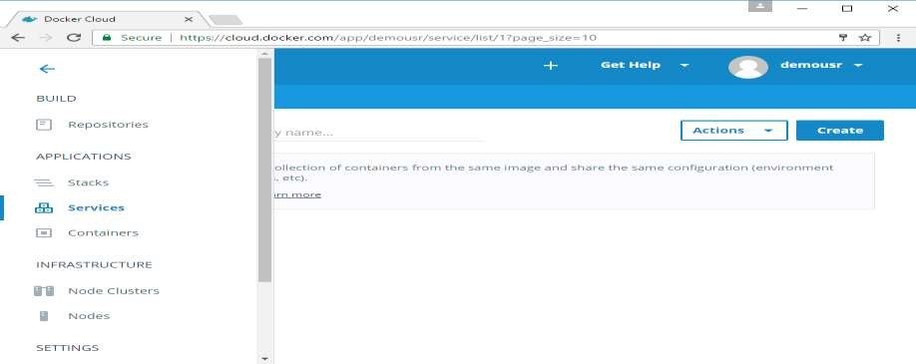
Deploying a Service
The next step after deploying a node is to deploy a service. To do this, we need to perform the following steps.
Step 1: Go to the Services Section in Docker Cloud. Click the Create button.

Slide 5
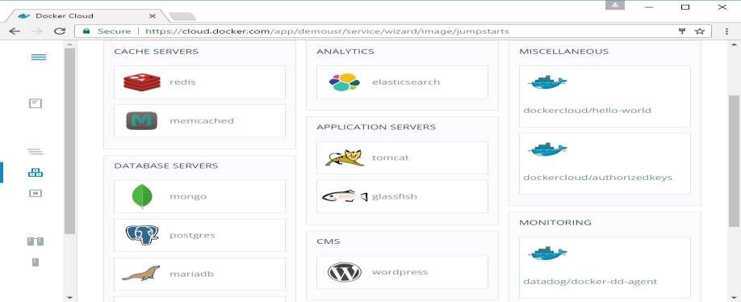
Step 2: Choose the Service which is required. In our case, let’s choose mongo.

Slide 6
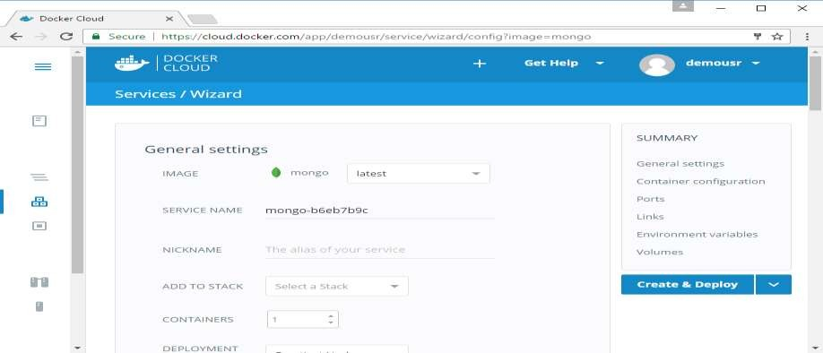
Step 3: On the next screen, choose the Create & Deploy option. This will start deploying the Mongo container on your node cluster.
Once deployed, you will be able to see the container in a running state.

Slide 7
Docker-Logging
Docker has logging mechanisms in place which can be used to debug issues as and when they occur. There is logging at the daemon level and at the container level. Let’s look at the different levels of logging.
Daemon Logging
At the daemon logging level, there are four levels of logging available:
Debug ─ It details all the possible information handled by the daemon process.
Info ─ It details all the errors + Information handled by the daemon process.
Errors ─ It details all the errors handled by the daemon process.
Fatal ─ It only details all the fatal errors handled by the daemon process.

Slide 8
Step 1: First, we need to stop the docker daemon process, if it is already running. It can be done using the following command:
Step 2: Now we need to start the docker daemon process. But this time, we need to append the –l parameter to specify the logging option. So let’s issue the following command when starting the docker daemon process.
The following points need to be noted about the above command:
dockerd is the executable for the docker daemon process.
The –l option is used to specify the logging level. In our case, we are putting this as debug.
& is used to come back to the command prompt after the logging has been enabled.

Slide 9
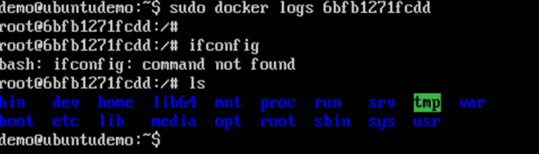
Container Logging
Logging is also available at the container level. So in our example, let’s spin up an Ubuntu container first. We can do it by using the following command.
Now, we can use the docker log command to see the logs of the container.
On our Docker Host, let’s issue the following command. Before that, you can issue some commands whilst in the container.
From the output, you can see that the commands executed in the container are shown in the logs.
sudo docker run –it ubuntu /bin/bash

Slide 10
Docker-Compose
Docker Compose is used to run multiple containers as a single service. For example, suppose you had an application which required NGNIX and MySQL, you could create one file which would start both the containers as a service without the need to start each one separately.
Docker Compose ─ Installation
The following steps need to be followed to get Docker Compose up and running.
Step 1: Download the necessary files from github using the following command:
curl -L "https://github.com/docker/compose/releases/download/1.10.0- rc2/docker- compose-$(uname -s)-$(uname -m)" -o /home/demo/docker-compose
The above command will download the latest version of Docker Compose which at the time of writing this article is 1.10.0-rc2. It will then store it in the directory /home/demo/.

Slide 11
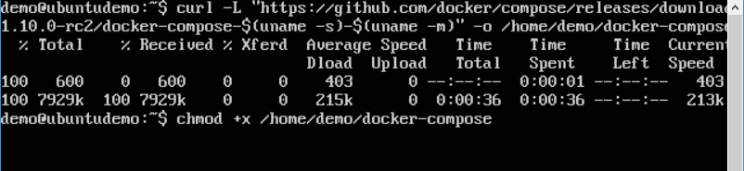
Step 2: Next, we need to provide execute privileges to the downloaded Docker Compose file, using the following command:
chmod +x /home/demo/docker-compose
We can then use the following command to see the compose version.
SYNTAX : docker-compose version
Parameters
version – This is used to specify that we want the details of the version of Docker Compose.
Output
The version details of Docker Compose will be displayed.

Slide 12
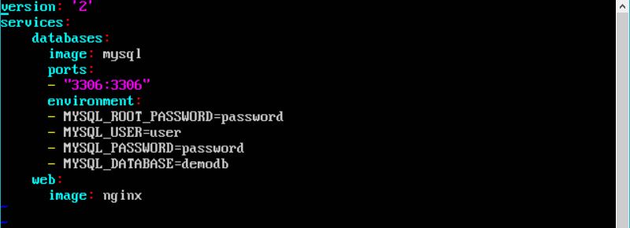
Creating your first Docker-Compose File
Now let’s go ahead and create our first Docker Compose file. All Docker Compose files are YAML files. You can create one using the vim editor. So execute the following command to create the compose file:
sudo vim docker-compose.yml

Slide 13
Let’s take a close look at the various details of this file:
The database and web keyword are used to define two separate services. One will be running our mysql database and the other will be our nginx web server.
The image keyword is used to specify the image from dockerhub for our mysql and nginx containers.
For the database, we are using the ports keyword to mention the ports that need to be exposed for mysql.
And then, we also specify the environment variables for mysql which are required to run mysql.
This command will take the docker-compose.yml file in your local directory and start building the containers.
Once executed, all the images will start downloading and the containers will start automatically.

Slide 14
KUBERNETES

Slide 15
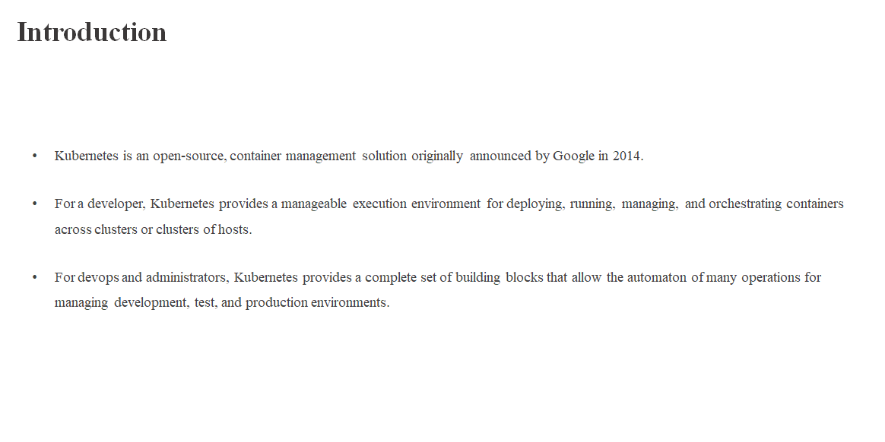

Slide 16
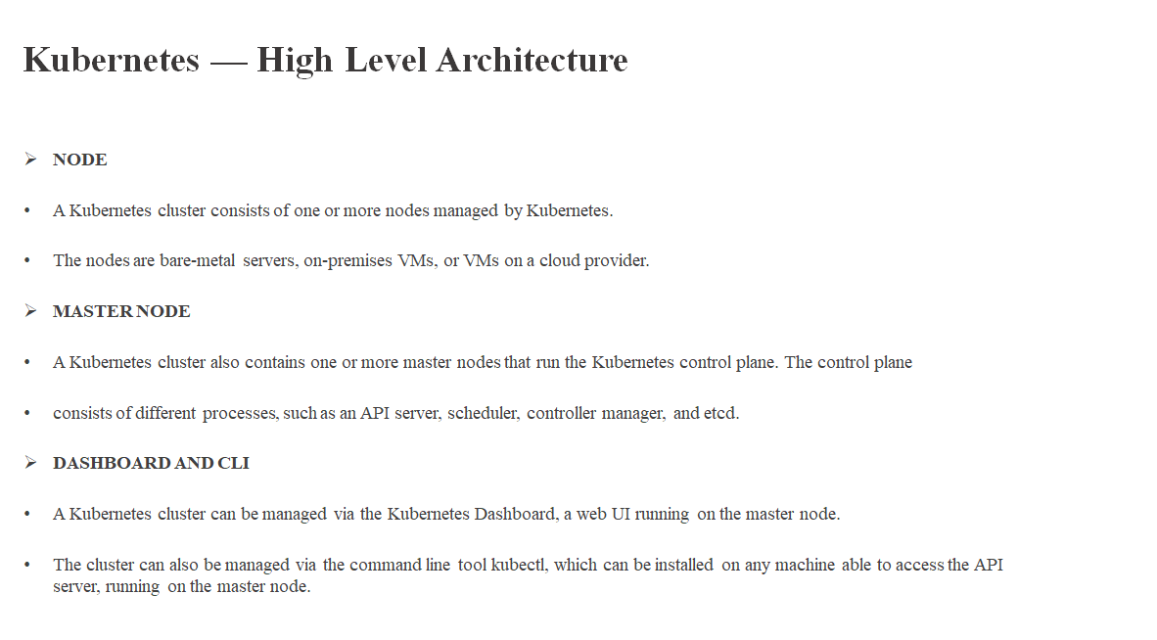

Slide 17
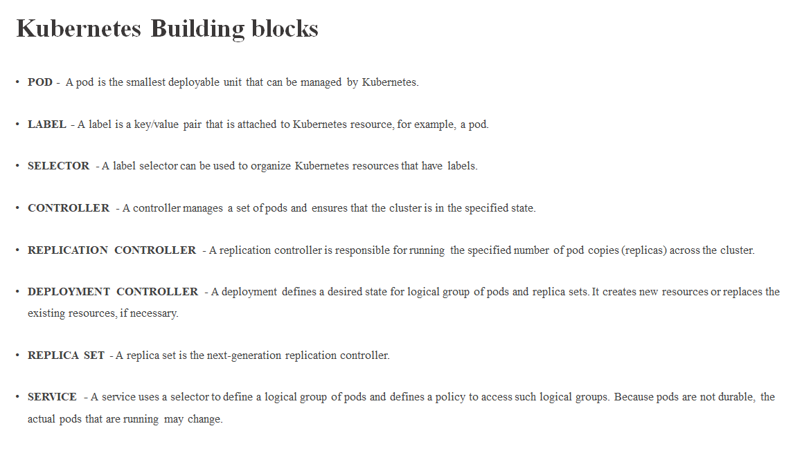

Slide 18
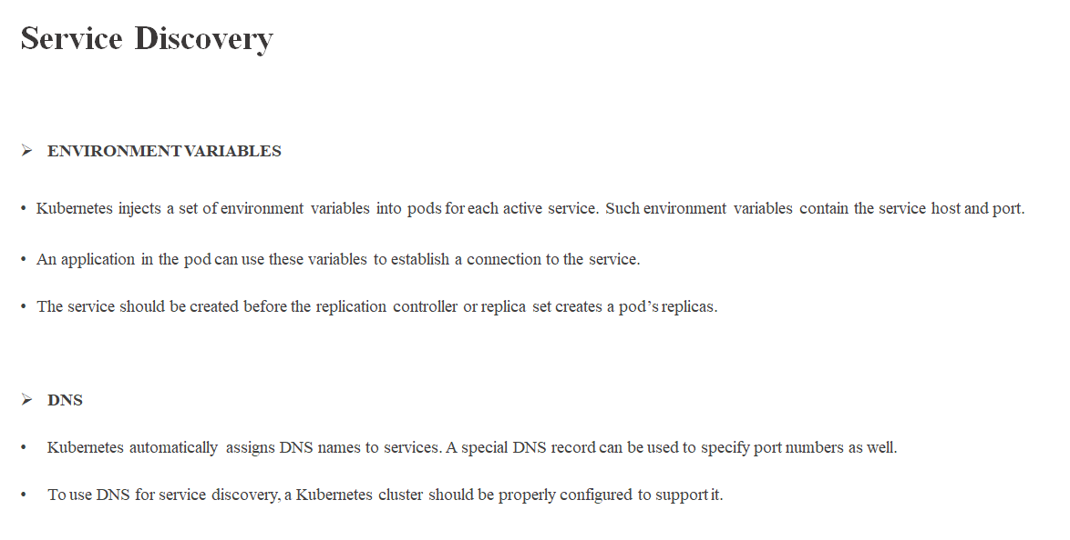

Slide 19
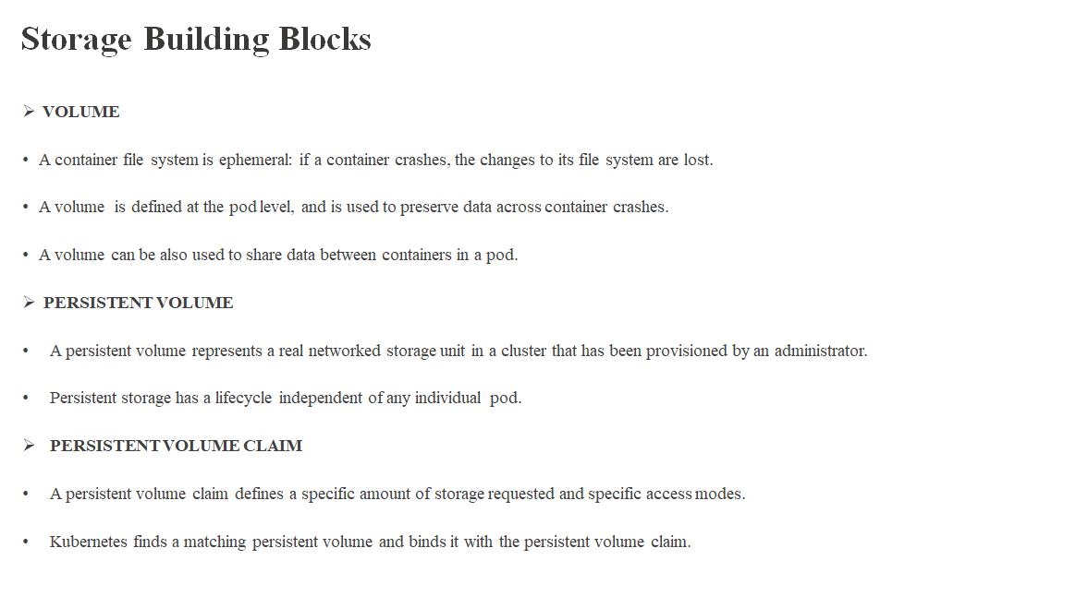

Slide 20
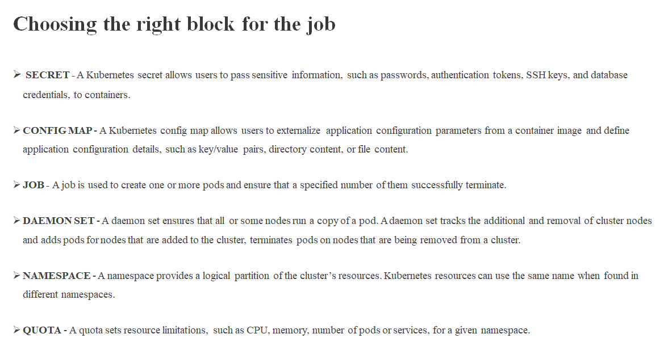

Slide 21
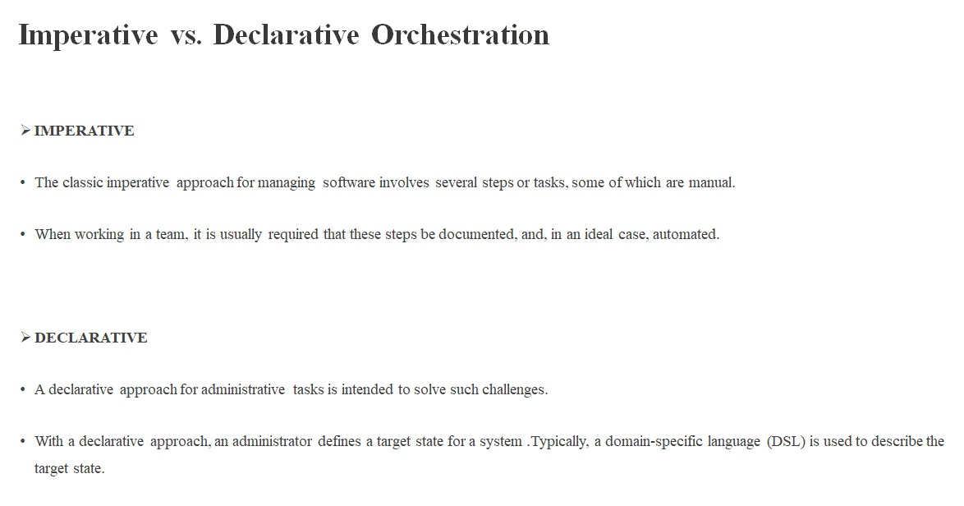

Slide 22
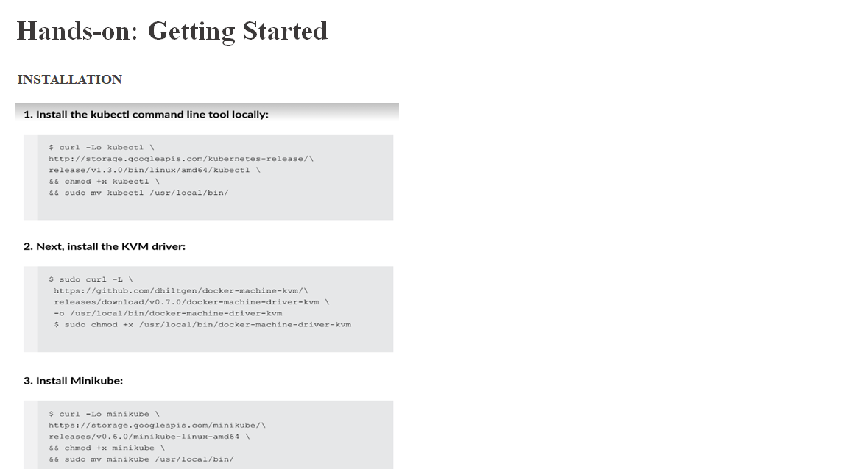

Slide 23
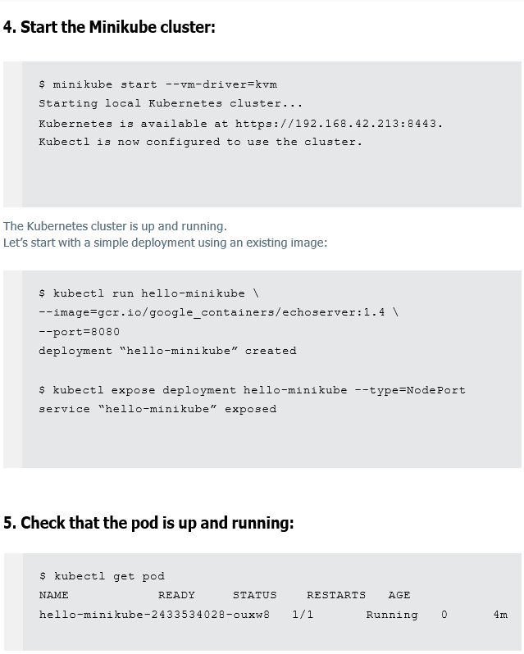

Slide 24
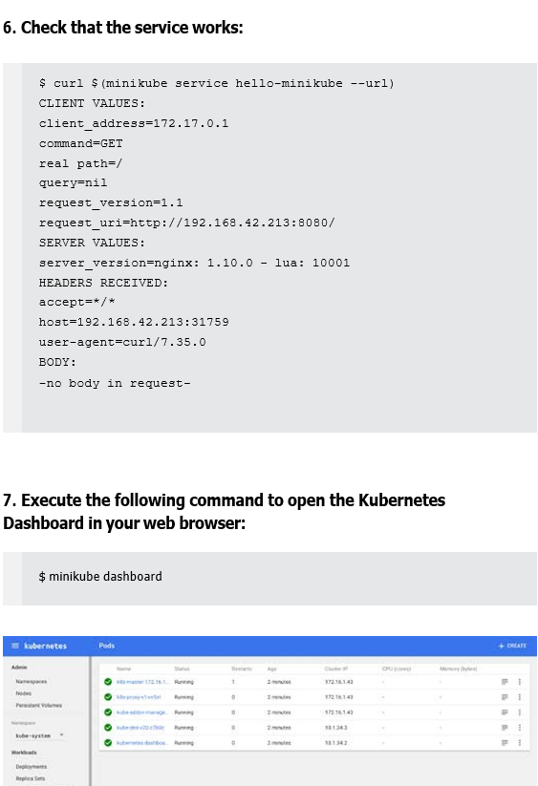

Slide 25
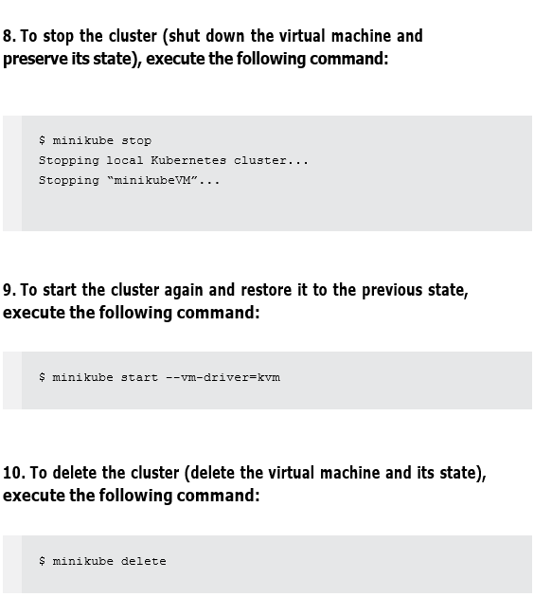

Slide 26
LOGGING
Basic logging in Kubernetes behaves much like logging in Docker. There is a kubectl logs command that will show you all the information written to stdout and stderr for a given container in a pod. If a pod has only one container, there is no need to specify it explicitly, however when a pod has several containers we need to add -c container to the end of the command.
As with Docker, we can opt to follow logs, to reduce the number of recent lines with --tail and we can filter them by date. Unlike Docker, Kubernetes enables us to check the logs of a container that crashed using the --previous option.

Slide 27
LOGGING
There are no cluster-level logging capabilities built into Kubernetes, but there are some common methods that can be implemented for this purpose.
DEDICATED AGENT RUNNING ON EVERY NODE
DEDICATED CONTAINER INSIDE A POD
DIRECT LOGGING FROM AN APPLICATION

Slide 28
MONITORING
As Kubernetes containers are actually Linux processes, we can use our favourite tools to monitor cluster performance. Basic tools, such as top or kubectl top, will behave as expected. It’s also possible to use solutions that are dedicated to Kubernetes. One such solution is Heapster

Slide 29
WORKING WITH MULTIPLE CLUSTERS
We have used kubectl to connect to only one cluster created by Minikube. But kubectl can be configured to use multiple clusters and multiple contexts to connect to them. To check available contexts, we use kubectl config get-contexts.

Slide 30
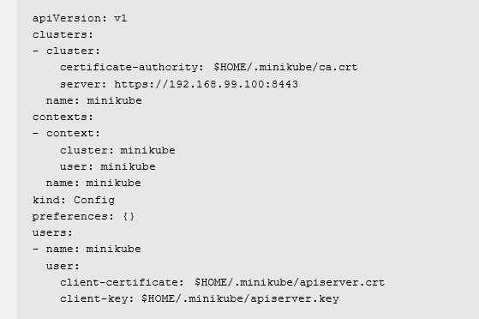
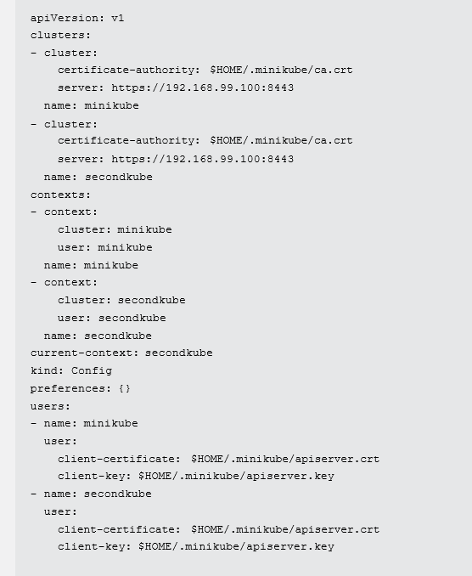

Slide 31
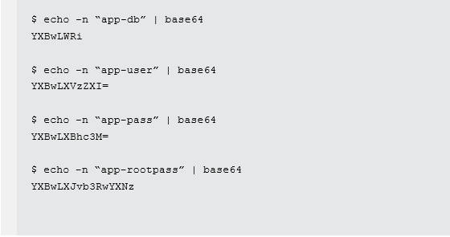
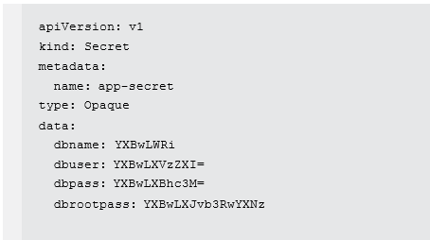
HANDS-ON: DEPLOYING AN APPLICATION
STEP 1. CREATE A KUBERNETES SECRET :
In the first step, we need to define a Kubernetes secret that contains a database name, user, and password. It should also contain the root password for MySQL.

Slide 32
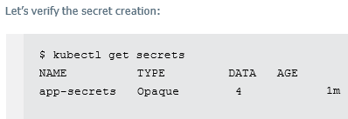

In the app-secret.yaml file, we specified the required Kubernetes API version and the data type to let Kubernetes know that we are defining a secret. In addition, the file defines four keys (dbname, dbuser, dbpass, dbrootpass) with the corresponding values we encoded above. Now we can create our Kubernetes secret using its definition in the app-secret.yaml file

Slide 33
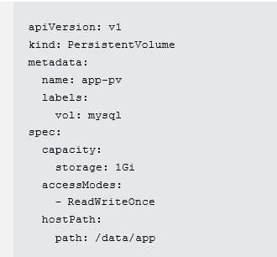
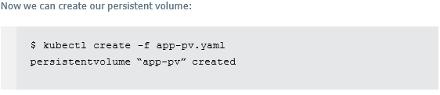
STEP 2. CREATE A PERSISTENT VOLUME:
To define a new persistent volume, create a new file, app-pv.yam, with the following content:

Slide 34
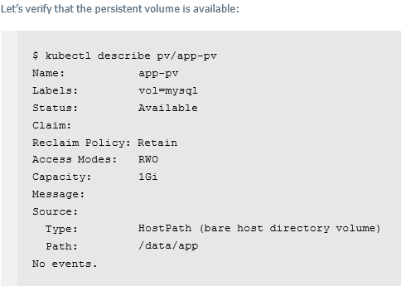

Slide 35
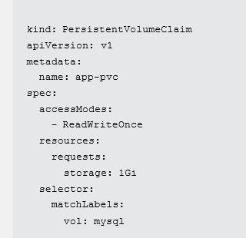

STEP 3. CLAIM A PERSISTENT VOLUME:
we need to claim our previously created persistent volume. Create a new file, app- pvc.yaml, with the following content:

Slide 36
STEP 4. DEPLOY MYSQL:
We will create a new deployment for MySQL using the existing Docker image. Create a new file, mysql-deployment.yaml, with the following content

Slide 37
